Slide 1
Business Leadership Academy Infographics
Here is where this template begins

Slide 2
About these infographics
This template contains an assortment of complementary infographic resources for the Business Leadership Academy Infographics presentation
These infographics are adapted to the style of the aforementioned presentation, so you can insert them easily and have them completely integrated at once. You just need to do the following:
Select the element that you want to copy
Right-click and choose “Copy”
Go to the slide where you want the element to appear
Right-click and choose “Paste”

Slide 3
Business leadership academy infographics
The discussion
Case studies
Group exercises
Practical projects
Saturn is a gas giant and has several rings
Despite being red, Mars is a cold place
Venus is the second planet from the Sun
Jupiter is the biggest planet of them all
1
2
3
4

Slide 4
Business leadership academy infographics
Leadership skills
Lead teams
Make strategic
Innovation
Jupiter is the biggest planet of them all
Mercury is the closest planet to the Sun
Saturn is a gas giant and has several rings
Despite being red, Mars is a cold place
Pluto is considered a dwarf planet
Earth is the third planet from the Sun

Slide 5
Business leadership academy infographics
Experience
Earth is the third planet from the Sun and the only one that harbors life
Skills
Mercury is the closest planet to the Sun and the smallest of them all
Ability
Venus has a beautiful name and is the second planet from the Sun

Slide 6
Business leadership academy infographics
1
Conflict resolution
Mercury is the closest planet to the Sun
2
Negotiation
Venus is the second planet from the Sun
3
Motivation
Despite being red, Mars is a very cold place

Slide 7
Business leadership academy infographics
Practice
Theory
Jupiter is an enormous planet
50%
Earth is the third planet from the Sun
40%
Consulting
Teamwork
Mercury is quite a small planet
70%
Venus is the second planet from the Sun
60%
Experience
Others
Despite being red, Mars is very cold
80%
Pluto is considered a dwarf planet
30%

Slide 8
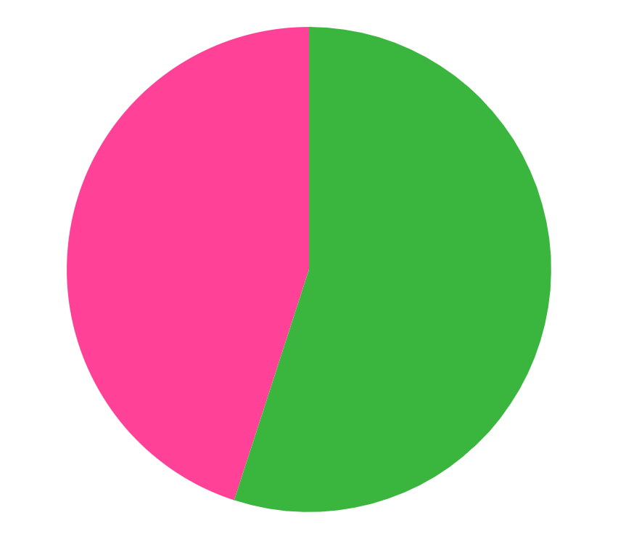
Business leadership academy infographics
Year | % | Success
20XX | 70% | Job hunting
20XX | 80% | Success on the job
20XX | 65% | Expertise
20XX | 85% | Promotions
20XX | 55% | Entrepreneurship
20XX | 75% | Recognition
45%
55%
Earth
Mars
Earth harbors life
Mars is a cold planet
Follow the link in the graph to modify its data and then paste the new one here. For more info, click here

Slide 9
Business leadership academy infographics
Where are our main academies located?
Mercury
Earth
Mercury is quite a small planet
Earth is a planet that has life
Jupiter
Mars
Jupiter is an enormous planet
Mars is actually a cold planet

Slide 10
Business leadership academy infographics
Post-academy courses
Hours | Credits | Courses
85 | 250 | Strategic management
50 | 185 | Project management
95 | 275 | Product I+D
60 | 195 | Virtual team management
75 | 210 | Conflict resolution
90 | 270 | Team leadership

Slide 11
Business leadership academy infographics
Most valued requirements
45%
50%
Certification
Experience
Mercury is the closest planet to the Sun
Venus is the second planet from the Sun
65%
70%
Skills
Test
Despite being red, Mars is a cold place
Jupiter is the biggest planet of them all

Slide 12
Business leadership academy infographics
Program
First semester
Strategic management | Mercury is small
Effective communication | Venus is hot
Change management | Saturn has rings
Second semester
Strategic thinking | Phobos is a moon
Team management | Earth has life
Business ethics | Jupiter is big
Third semester
Communication | Neptune is far away
Talent management | The Sun is a star
Change management | Mars is red
Internship
Strategic thinking | Uranus is blue
Team management | Pluto isn’t a planet
Business ethics | Io is a moon too

Slide 13
Business leadership academy infographics
1
Comprehensive curriculum
Jupiter is the biggest planet of them all
2
Leadership focus
Mercury is the closest planet to the Sun
3
Practical experience
Despite being red, Mars is very cold
4
Leadership experts
Saturn is composed of hydrogen and helium

Slide 14
Business leadership academy infographics
First day. Monday, September 4, 20XX
Despite being red, Mars is actually a cold place
2nd semester. Monday, February 5, 20XX
Neptune is the fourth-largest planet in the Solar System
Course end. Saturday, June 14, 20XX
Earth is the only planet known to harbor life

Slide 15
Business leadership academy infographics
Program | Description | Room
8:00 - 10:00 | Academy introduction | Room 4
10:10 - 12:00 | Teacher presentation | Room 5
12:15 - 14:00 | Student presentation | Room 5
14:05 - 16:00 | Lunch and meet | Lunch room
16:05 - 18:00 | Program explanation | Room 3
18:15 - 18:45 | End of the first day of presentation | Room 3

Slide 16
Business leadership academy infographics
Fee payment
Admission notification
Mercury is quite a small planet
Earth is a planet that harbors life
1
2
3
4
Registration delivery
Interview & evaluation
Jupiter is an enormous planet
Mars is actually a very cold place

Slide 17
Business leadership academy infographics
September
Mo | Tu | We | Th | Fr | Sa | Su
 |  |  | 1 | 2 | 3 | 4
5 | 6 | 7 | 8 | 9 | 10 | 11
12 | 13 | 14 | 15 | 16 | 17 | 18
19 | 20 | 21 | 22 | 23 | 24 | 25
26 | 27 | 28 | 29 | 30
First day
09.04
Earth is the third planet from the Sun
First practice
09.14
Mercury is the closest planet to the Sun
First exam
09.26
Venus has a beautiful name and is the second planet

Slide 18
Business leadership academy infographics
Objectives
01
02
03
Enhancing critical thinking
Promoting business ethics
Developing leadership skills
Jupiter is the biggest planet of them all
Saturn is composed of hydrogen and helium
Pluto is classified as a dwarf planet
Mercury is the closest planet to the Sun
Despite being red, Mars is a cold place
Earth is the third planet from the Sun

Slide 19
Business leadership academy infographics
Student age ranges
Age | Description | Percentages
18-25 | Mercury is a small planet | 60%
26-35 | Venus has extremely high temperatures | 55%
36-45 | Earth is the planet with life | 80%
46-55 | Mars is full of iron oxide dust | 20%

Slide 20
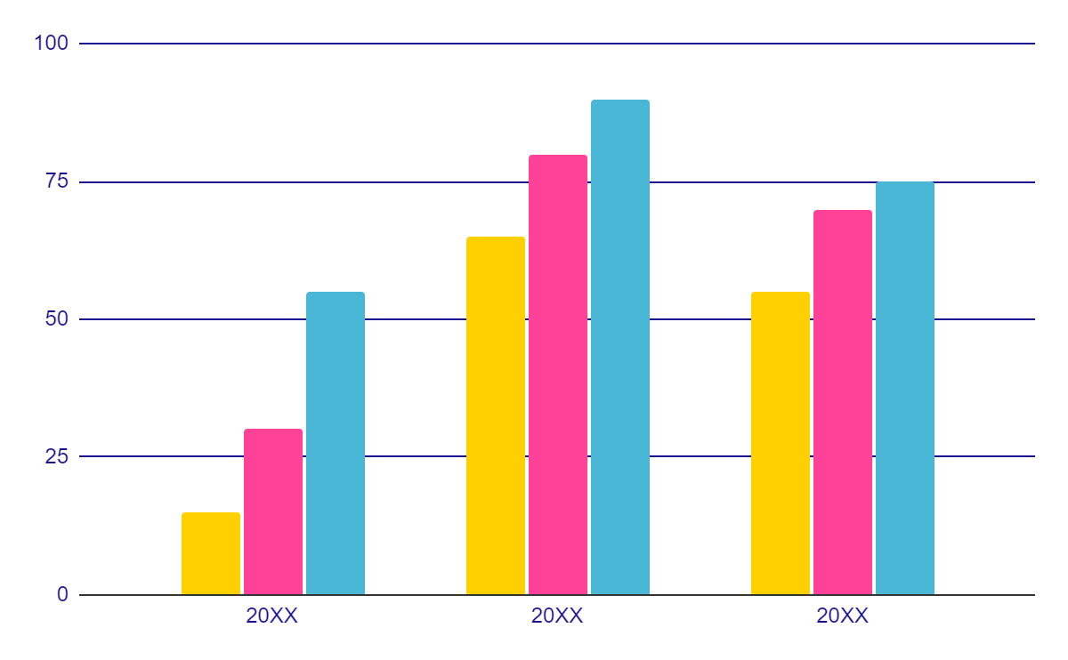
Business leadership academy infographics
Students enrolled per year
Women
Earth is the third planet from the Sun and has life
Men
Mercury is the closest planet to the Sun
Others
Venus is the second planet from the Sun
Follow the link in the graph to modify its data and then paste the new one here. For more info, click here

Slide 21
Business leadership academy infographics
Professional
Consulting
Jupiter is an enormous planet
Mercury is a very small planet
Practice
Teachers
Mars is actually a very cold place
Advantages
Venus has a beautiful name
Diversity
Teamwork
Saturn is a gas giant and has rings
Neptune is very far from the Sun

Slide 22
Business leadership academy infographics
Enrollment process
01
02
Venus is the second planet from the Sun
Despite being red, Mars is actually a cold place
03
04
05
Jupiter is the biggest planet in the Solar System
Saturn is composed of hydrogen and helium
Neptune is the farthest planet from the Sun

Slide 23
Business leadership academy infographics
Schedule
 | Mon | Tue | Wed | Thu | Fri
9:00 | Subject 1 | Subject 2 | Subject 3 | Subject 6 | Subject 5
10:00 | Subject 3 | Subject 1 | Subject 6 | Subject 4 | Subject 2
11:00 | Subject 6 | Subject 4 | Subject 1 | Subject 1 | Subject 6
12:00 | Subject 2 | Subject 6 | Subject 2 | Subject 3 | Subject 1
13:00 | Subject 4 | Subject 5 | Subject 4 | Subject 5 | Subject 3
15:00 | Subject 5 | Subject 3 | Subject 5 | Subject 2 | Subject 4

Slide 24
Business leadership academy infographics
355
Students per year
 | Q1 | Q2 | Q3
Subject 1 | 7 | 9 | 9
Subject 2 | 8 | 8 | 9
Subject 3 | 9 | 9 | 9
Subject 4 | 7 | 9 | 9
Subject 5 | 9 | 9 | 9
Subject 6 | 7 | 9 | 9
Subject 7 | 8 | 7 | 9
Total credits
01 | 55
02 | 60
03 | 63

Slide 25
Business leadership academy infographics
20%
 |  | Description
Theory |  | Jupiter is a gas giant and the biggest planet in the entire Solar System
Practice |  | Despite being red, Mars is actually a cold planet. It’s full of iron oxide dust
Theory
Venus has a beautiful name and is the second planet from the Sun
80%
Practice
Earth is the third planet from the Sun and the only one that harbors life

Slide 26
Business leadership academy infographics
Our academy
Mission
Values
Vision
Venus is the second planet from the Sun
Earth is the only planet known to harbor life
Despite being red, Mars is very cold
Pluto is considered a dwarf planet
Mercury is the closest planet to the Sun
The Sun is the closest star to our planet
Jupiter doesn’t have a solid surface
Saturn is composed of hydrogen and helium
Neptune is very far from the Sun

Slide 27
Business leadership academy infographics
Main goals
Students leave with a professional career
Mercury is the closest planet to the Sun and the smallest one of them all
Professional students able to lead any team
Venus has a beautiful name and is the second planet from the Sun

Slide 28
Business leadership academy infographics
Leadership examples
Autocratic
Democratic
Transformational
Mercury is the closest planet to the Sun
Venus is the second planet from the Sun
Earth is the third planet from the Sun
Situational
Charismatic
Helpful
Despite being red, Mars is actually a cold place
Neptune is the farthest planet from the Sun
Jupiter is the biggest planet of them all

Slide 29
Business leadership academy infographics
Requirements
Notes
Saturn is the ringed planet
Mars is full of iron oxide dust
Jupiter doesn’t have a solid surface
Earth is the only planet known to harbor life
Neptune is very far from the Sun
01
Despite being red, Mars is actually a cold place. It's full of iron oxide dust
02
Venus has a beautiful name and is the second planet from the Sun
Summary
Mercury is the closest planet to the Sun and the smallest one in the entire Solar System. This planet’s name has nothing to do with the liquid metal. It has no known moons
03
Mercury is the closest planet to the Sun and the smallest of them all

Slide 30
Business leadership academy infographics
Student list
Admitted students
01 | Josh Miller
02 | Anna Williams
03 | Michael Brown
04 | Helen Davis
05 | Mery Wilson
06 | Jon Jackson
07 | Henry Lee
Admitted students
08 | Noah Walker
09 | Chloe Scott
10 | Grace Adams
11 | Anne Roberts
12 | Martin Philips
13 | Riley Turner
14 | Daniel Collins
Waiting list
01 | John Murphy
02 | Ethan Cooper
03 | Emma Reed
04 | Zoe Watson

Slide 31
Business leadership academy infographics
Integrity
Empathy
Flexibility
Motivation
You can write here
You can write here
You can write here
You can write here
You can write here
You can write here
You can write here
You can write here
You can write here
You can write here
You can write here
You can write here
You can write here
You can write here
You can write here
You can write here
You can write here
You can write here
You can write here
You can write here

Slide 32
Business leadership academy infographics
Subject | Theory | Practice | Description
Subject 1 | X | X | Jupiter is an enormous planet
Subject 2 | X |  | Mars is actually a cold place
Subject 3 |  | X | Venus has a toxic atmosphere
Subject 4 | X | X | Earth is the planet with life
Subject 5 | X | X | Mercury is quite a small planet
Subject 6 | X |  | Saturn is a gas giant

Slide 33
Instructions for use
If you have a free account, in order to use this template, you must credit Slidesgo in your final presentation. Please refer to the next slide to read the instructions for premium users.
As a Free user, you are allowed to:
- Modify this template.
- Use it for both personal and commercial projects.
You are not allowed to:
- Sublicense, sell or rent any of Slidesgo Content (or a modified version of Slidesgo Content).
- Distribute Slidesgo Content unless it has been expressly authorized by Slidesgo.
- Include Slidesgo Content in an online or offline database or file.
- Offer Slidesgo templates (or modified versions of Slidesgo templates) for download.
- Acquire the copyright of Slidesgo Content.
For more information about editing slides, please read our FAQs or visit our blog:
https://slidesgo.com/faqs and https://slidesgo.com/slidesgo-school

Slide 34
Instructions for use (premium users)
As a Premium user, you can use this template without attributing Slidesgo.
You are allowed to:
Modify this template.
Use it for both personal and commercial purposes.
Share this template in an editable format with people who are not part of your team.
You are not allowed to:
Sublicense, sell or rent this Slidesgo Template (or a modified version of this Slidesgo Template).
Distribute this Slidesgo Template (or a modified version of this Slidesgo Template) or include it in a database or in any other product or service that offers downloadable images, icons or presentations that may be subject to distribution or resale.
Use any of the elements that are part of this Slidesgo Template in an isolated and separated way from this Template.
Register any of the elements that are part of this template as a trademark or logo, or register it as a work in an intellectual property registry or similar.
For more information about editing slides, please read our FAQs or visit our blog:
https://slidesgo.com/faqs and https://slidesgo.com/slidesgo-school

Slide 35
Infographics
You can add and edit some infographics to your presentation to present your data in a visual way.
Choose your favourite infographic and insert it in your presentation using Ctrl C + Ctrl V or Cmd C + Cmd V in Mac.
Select one of the parts and ungroup it by right-clicking and choosing “Ungroup”.
Change the color by clicking on the paint bucket.
Then resize the element by clicking and dragging one of the square-shaped points of its bounding box (the cursor should look like a double-headed arrow). Remember to hold Shift while dragging to keep the proportions.
Group the elements again by selecting them, right-clicking and choosing “Group”.
Repeat the steps above with the other parts and when you’re done editing, copy the end result and paste it into your presentation.
Remember to choose the “Keep source formatting” option so that it keeps the design. For more info, please visit our blog.

